Slide 1


Home
Photo
About Us
Contact
Software
Requirement
Analysis
Haat Baran
Presented By
Mostofa Hasin Mahdi
223071109
Talal Sharar Apurbo
223071108
31st Batch, Group - (A)
Dept. of CSE

Slide 2

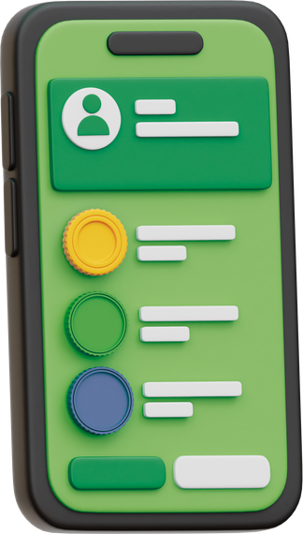

Introduction
Haat Baran
Software Requirement Specification (SRS) describes the requirements for the Haat Baran project , a digital funding and verification platform for underprivileged individuals seeking startup capital to begin small businesses.
Haat Baran will consist of three primary interfaces:
Volunteer App
Donor Portal
Admin Dashboard
For trained field workers to visit applicants, collect their details, photos, and location, and submit this information to the central system.
Designed for donors to view verified profiles of applicants, check their background and business goals, and securely contribute funds using digital payment gateways
A web based control panel for approving applicants, monitoring funding flow, generating reports, and ensuring transparency
1
2
3

Slide 3







System Architecture
Haat Baran
The Haat Baran system is built on a client-server architecture, structured around three core modules
Applicant
Volunteer
Web Server
Admin
Database
Donor
Web Server
Web Portal

Slide 4

System Model
Haat Baran
Use cases describe the interaction between the user and the system to achieve specific goals
Use Case Diagram
Use Case | Title
UC1 | Applicant Registration
UC2 | Volunteer Login
UC3 | Applicant Verification and Approval
UC4 | Donor Registration and Login
UC5 | View and Fund Verified Applicants
UC6 | Donation Request
UC7 | Send Funding Notification
UC8 | Generate Report and Progress Data
Applicant Registration
Volunteer
Admin
Volunteer Login
Applicant Veriification
Donor Registration/Login
Select Applicant
Donor
Applicant
Donation Request
Completion Report

Slide 5



System Evolution
Haat Baran
The Haat Baran system is designed to be flexible, upgradable, and scalable according to user demand and technological changes.
Version 1.0
Version 2.0
Version 3.0
Core functions: volunteer registration, applicant verification, donor funding, and admin control panel.
Introduction of post-funding tracking and automated progress reports for donors
Expansion with AI-driven verification assistance, fraud detection, and predictive funding suggestions.
1
2
3

Slide 6
Haat Baran
Thank You

